Slide 1
Surgical Video Generation
Liu Junlin, Wang Qianyi
Advisor: Liu Jiang, Hu Yan

Slide 2
Contents
Background
Modeling Tasks
Video Generation
Frame Interpolation
Further Works

Slide 3
Background
Medical model training needs
Surigical videos are extracted frames, not much motion information are given
Lack of details in videos
Lack of video datasets in rare surgical cases

Slide 4
Modeling Tasks
Generate Surgical Images in Different Stages (Done)
Generate Surgical Videos in Different Stages
Surgical Video Frame Interpolation

Slide 5
Video Generation
PART I

Slide 6
Content
Vidu: a Highly Consistent, Dynamic and Skilled Text-to-Video Generator with Diffusion Models
Lumina-T2X: Transforming Text into Any Modality, Resolution, and Duration via Flow-based Large Diffusion Transformers

Slide 7
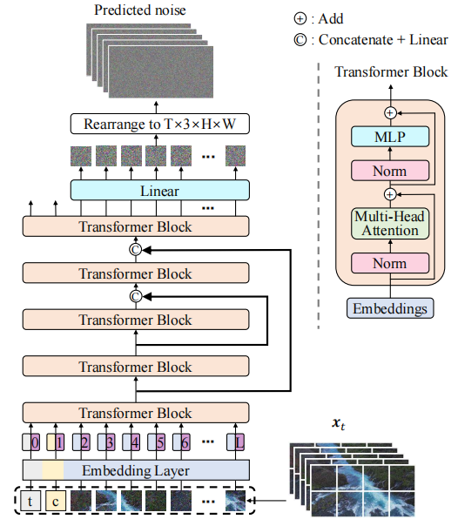
Vidu
Video autoencoder to reduce both the spatial and temporal dimensions.
Vidu employs a U-ViT as the noise prediction network to model these compressed representations.
Train a high-performance video captioner optimized for understanding dynamic information in videos, and then automatically annotate all the training videos using this captioner.

Slide 8
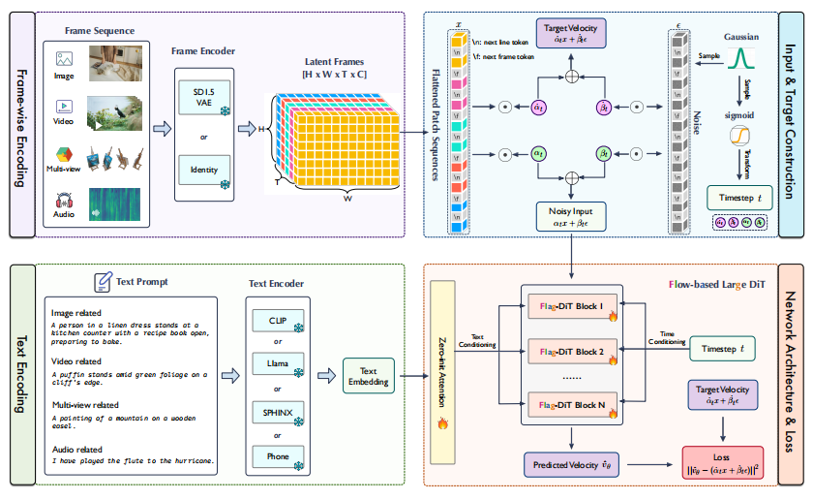
Lumina-T2X

Slide 9
Frame-wise Encoding of Different Modalities
The key ingredient for unifying different modalities within framework is treating images, videos, multi-view images, and speech spectrograms as frame sequences of length T.
Specifically, for images (T = 1), videos (T = numframes), and multiview images (T = numviews)
Use SD 1.5 VAE to independently encode each image frame into latent space and concatenate all latent frames together

Slide 10
Text Encoding with Diverse Text Encoders
For text-conditional generation, encode the text prompts using pre-trained language models.
Specifically, incorporate a variety of diverse text encoders with varying sizes, including CLIP, LLaMA, SPHINX, and Phone encoders, tailored for various needs and modalities, to optimize text conditioning.

Slide 11
Input & Target Construction
Latent frames are first flattened using 2×2 patches into a 1-D sequence, then added with [nextline] and [nextframe] tokens as identifiers.
Adopt the time resampling strategy to sample timestep from a log-norm distribution during training.
Specifically, first sample a timestep from a normal distribution N (0, 1) and map it to [0, 1] using the logistic function in order to emphasize the learning of intermediate timesteps.

Slide 12
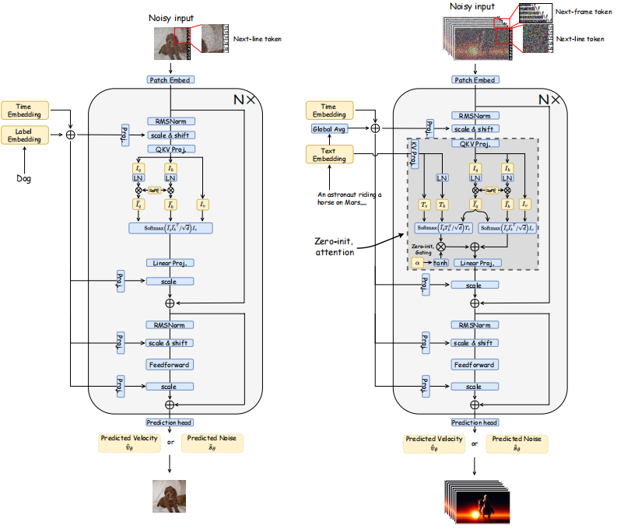
Network Architecture & Loss
Use Flag-DiT as denoising backbone.
Add RMSNorm at the start of each attention and MLP block to prevent the absolute values grow uncontrollably causing numerical instability

Slide 13
Frame Interpolation
PART II

Slide 14
Content:
Modification
LDMVFI+: Video Frame Interpolation with Latent Diffusion Models
Train
Comparison

Slide 15
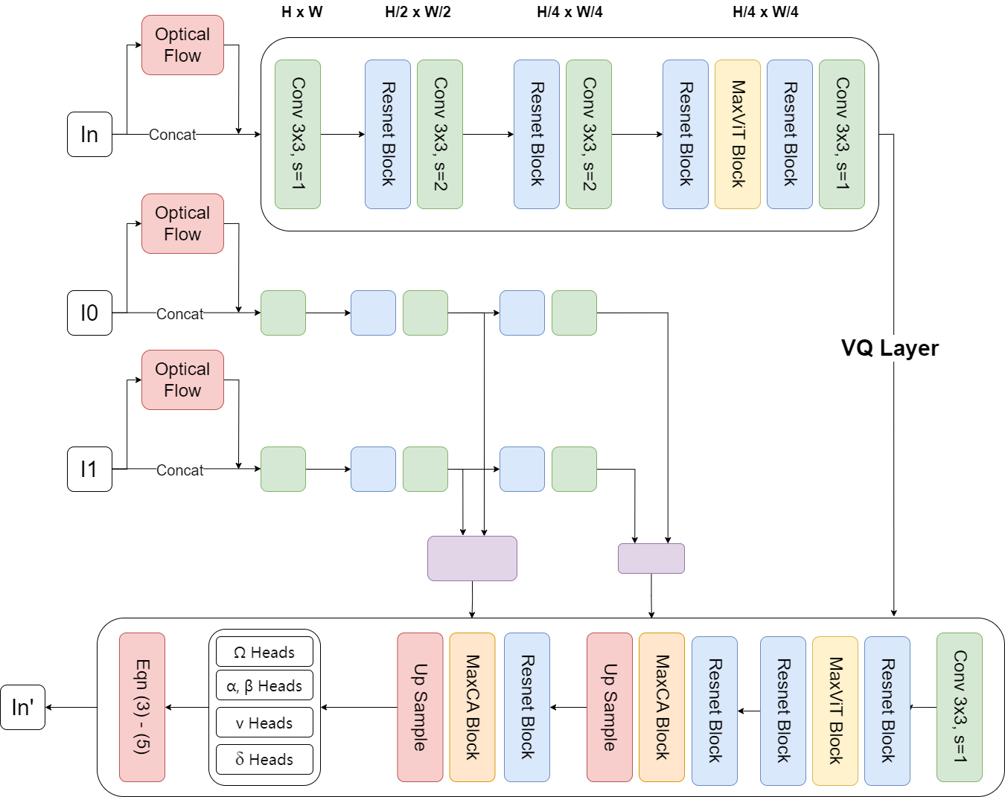
LDMVFI+: Video Frame Interpolation with Latent Diffusion Models with optical flow
At the very beginning of the image, we extracted optical flow features and added them to the input to guide the extraction of image features.

Slide 16
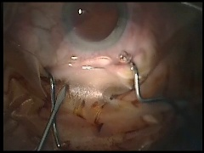
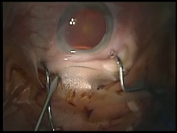
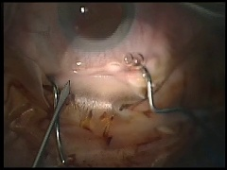
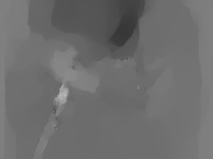
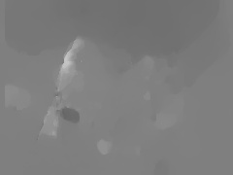
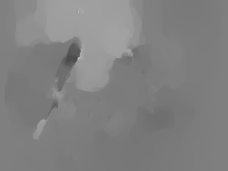
Optical Flow: Extracting Optical Flow Features for guidance

Slide 17
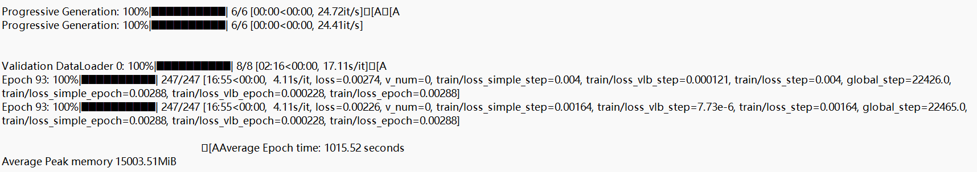
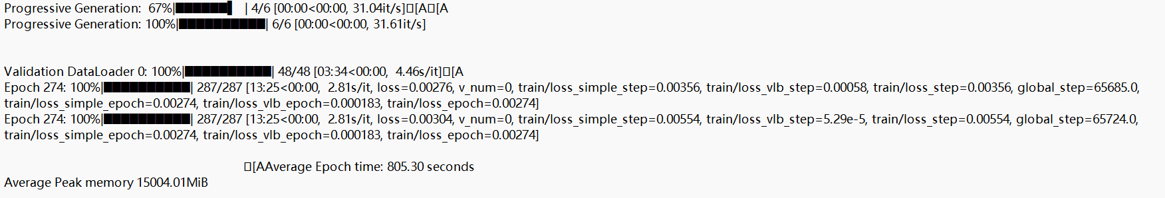
Train:
Decoder
Encoder

Slide 18
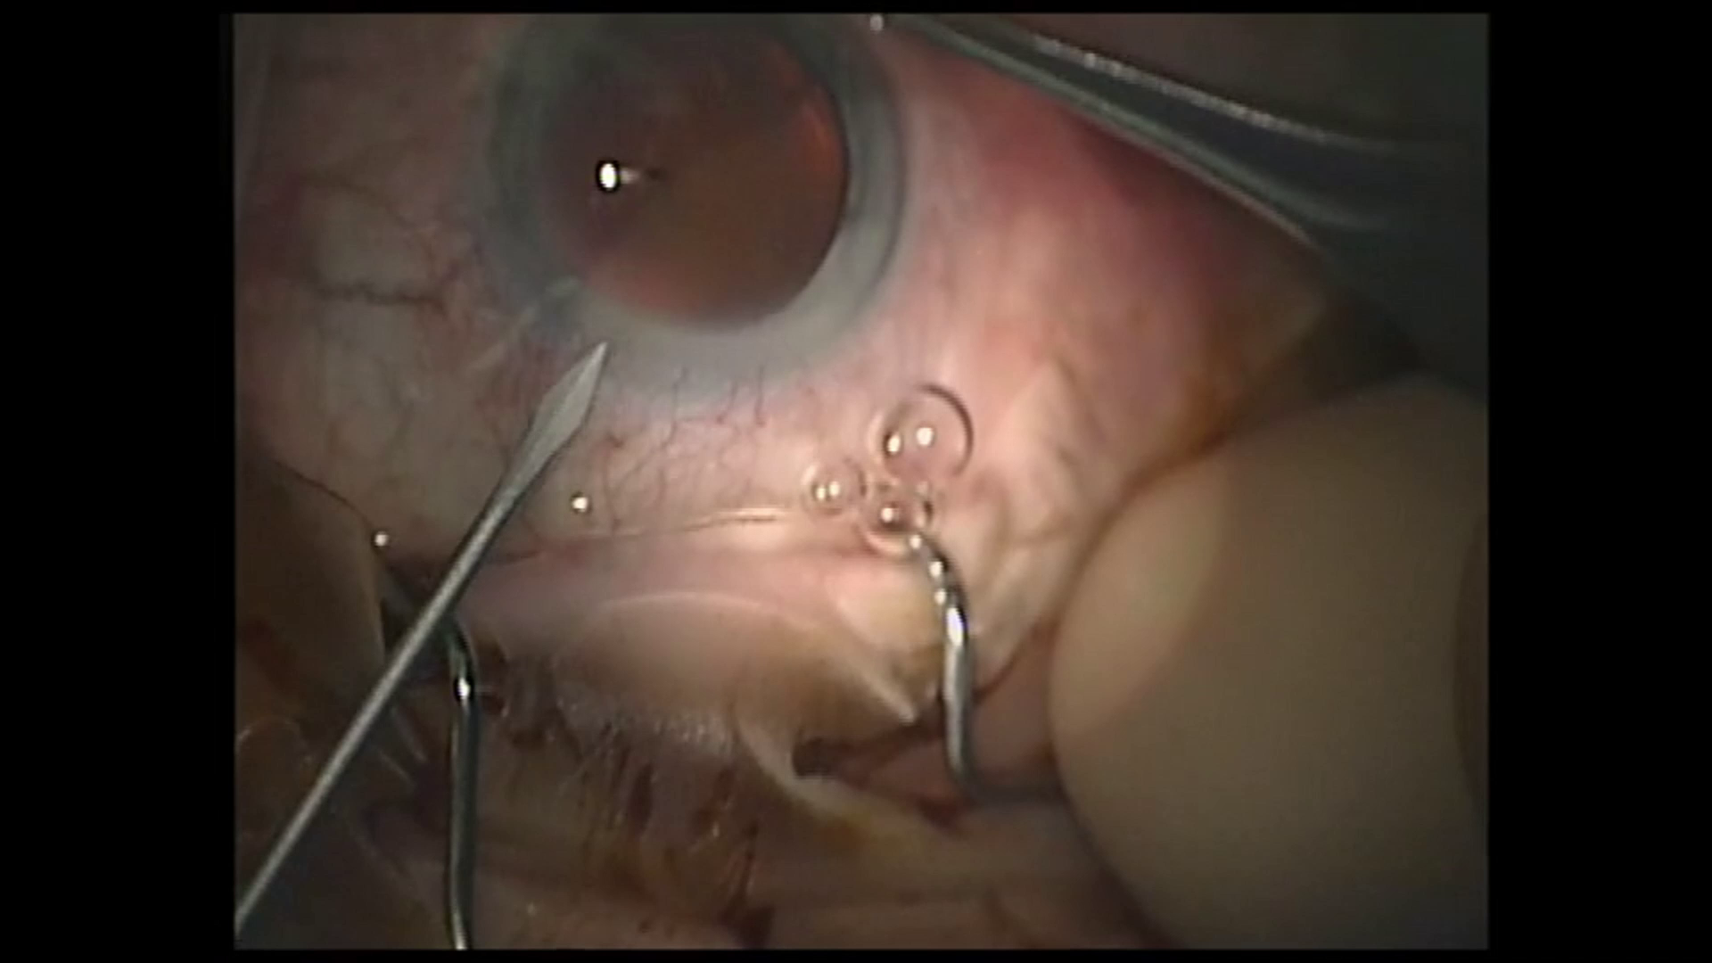



Comparison(1): LDMVFI+
Clipped2FPS
Original
Optical
Flow
LDMVFI

Slide 19
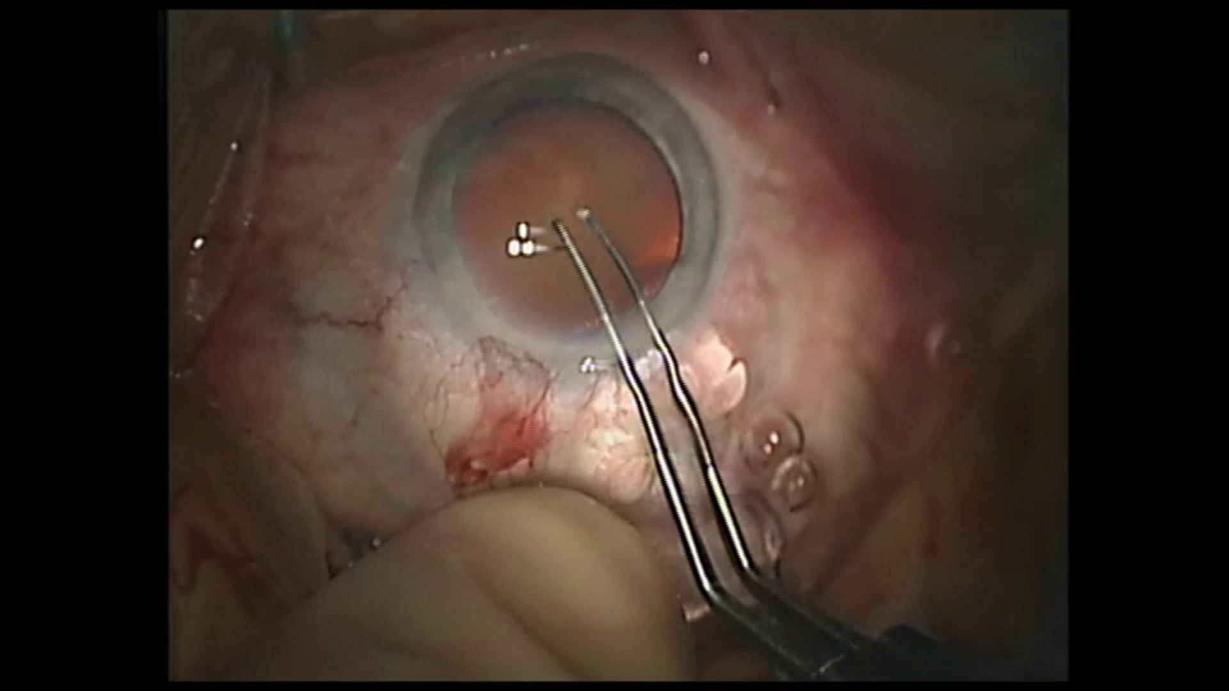



Comparison(2): LDMVFI+
Clipped2FPS
Original
Optical
Flow
LDMVFI

Slide 20
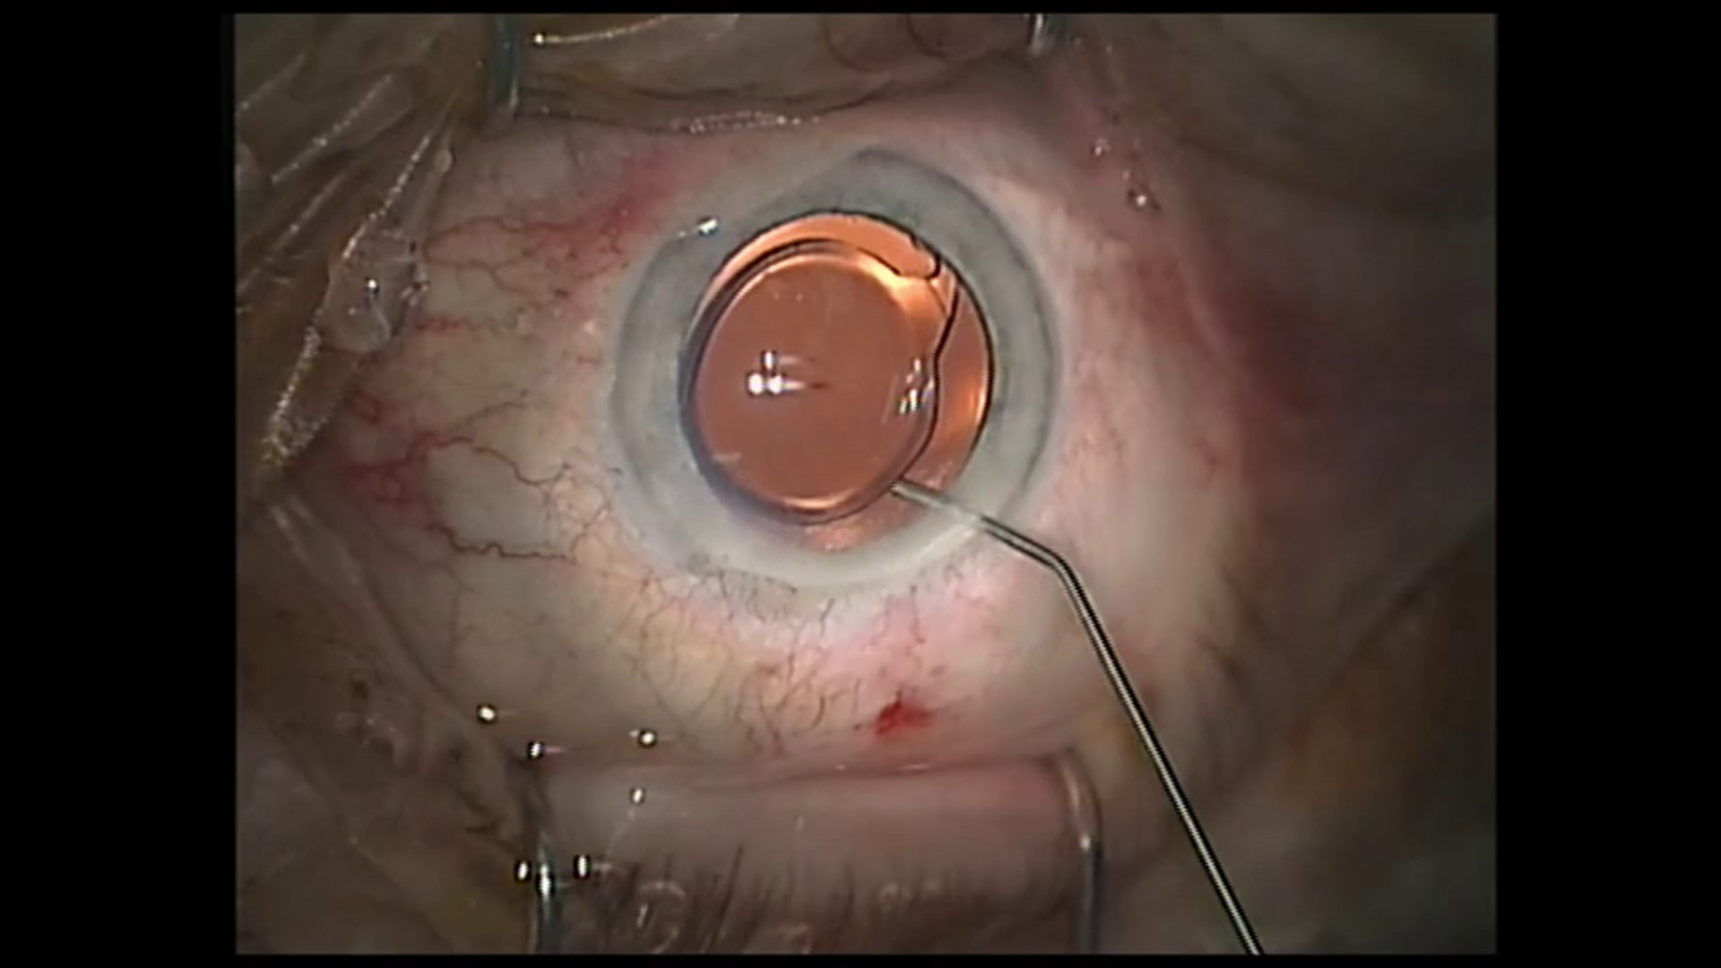
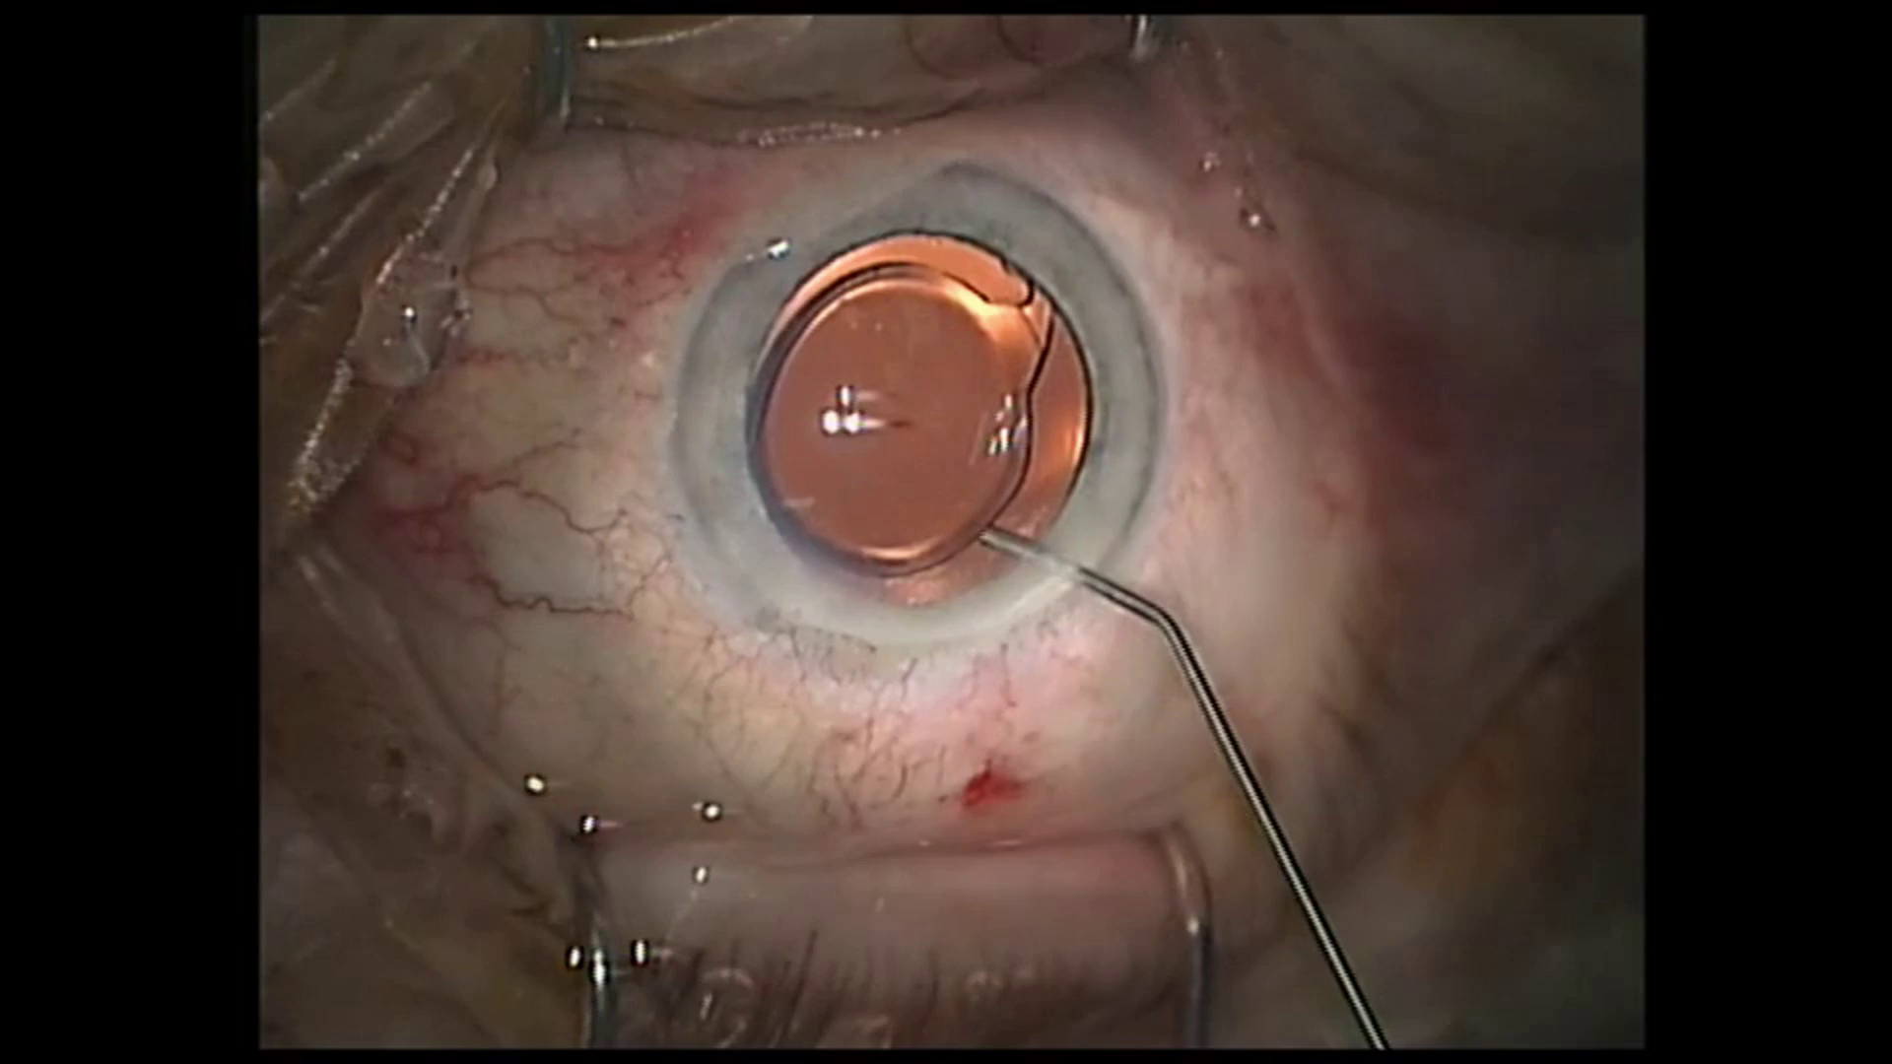


Comparison(3): LDMVFI+
Original
Clipped2FPS
Optical
Flow
LDMVFI

Slide 21
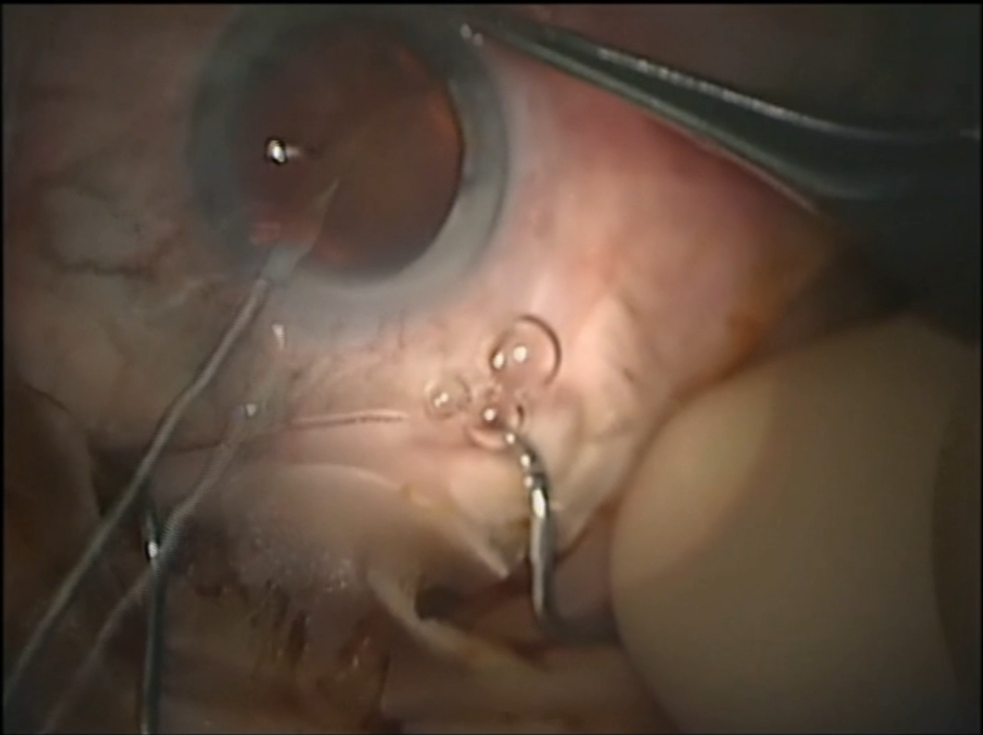
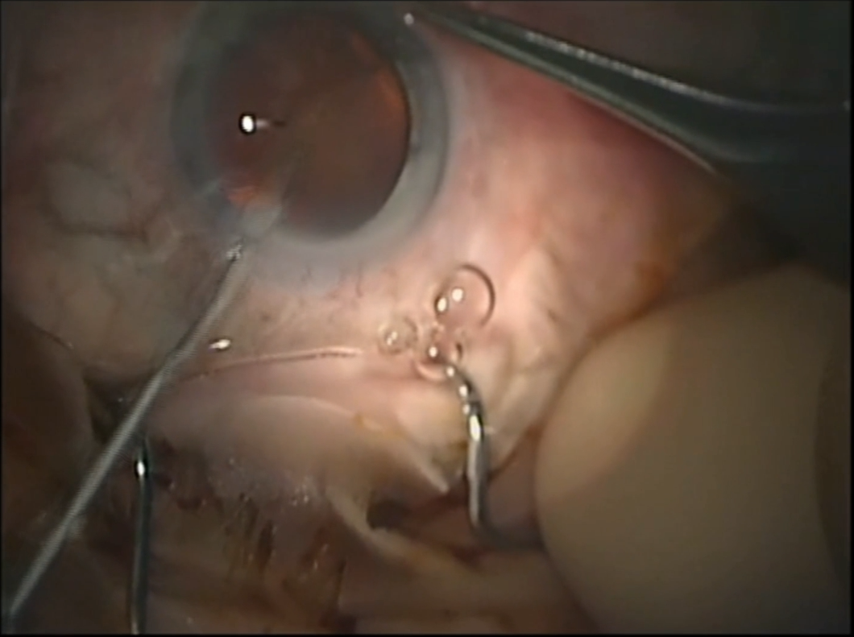
Conclusion:
From the result, we can see that artifact still exists, but they are very rare

Slide 22
Further Works
PART III

Slide 23
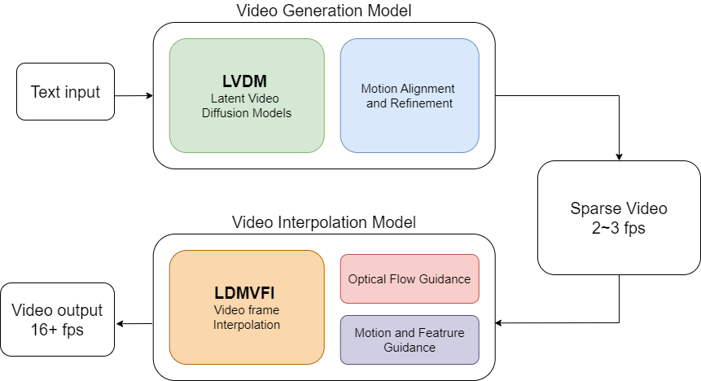
Pipeline

Slide 24
Main Idea
Integrate video diffusion models with motion alignment and refinement.
Modify LDMVFI with motion and feature extraction for better frame interpolation.

Slide 25
Thanks for Your Attention

